Slide 1

Introduction to Machine Learning 2
Classification

Slide 2
Copyright Notice
The material within this presentation, excluding externally sourced images and animations, is fully owned by the Curtin Machine Learning Club. No redistributing, modification, nor commercialisation is allowed without written consent from the copyright holder.
Copyright © 2022 Curtin Machine Learning Club

Slide 3
Acknowledgement of Country
Curtin University would like to pay our respect to the Aboriginal and Torres Strait Islander members of our community by acknowledging the traditional owners of the land on which the Bentley Campus is located, the Wadjuk people of the Nyungar Nation; and on our Kalgoorlie Campus, the Wongutha people of the North-Eastern Goldfields, past, present, and emerging.

Slide 4


Hardware Required

Slide 5
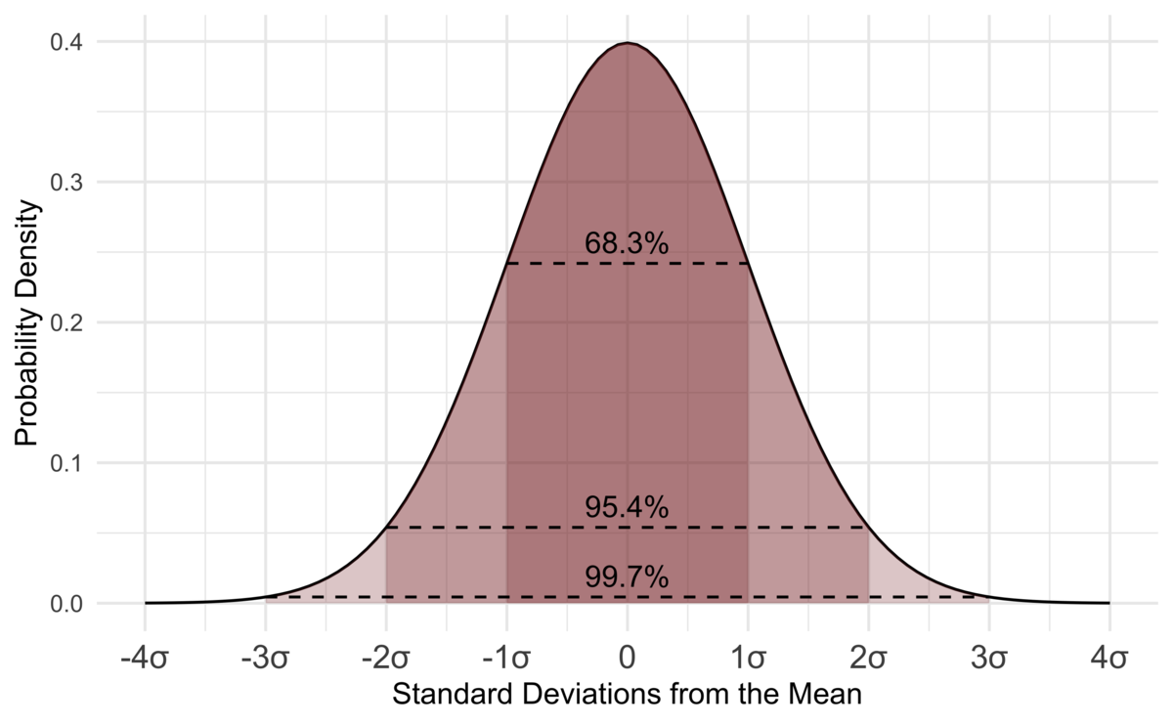

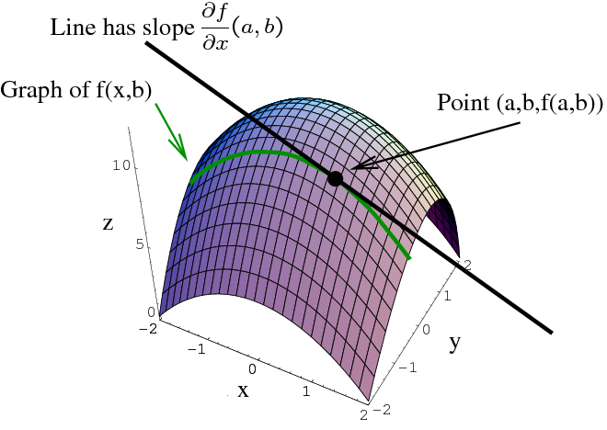
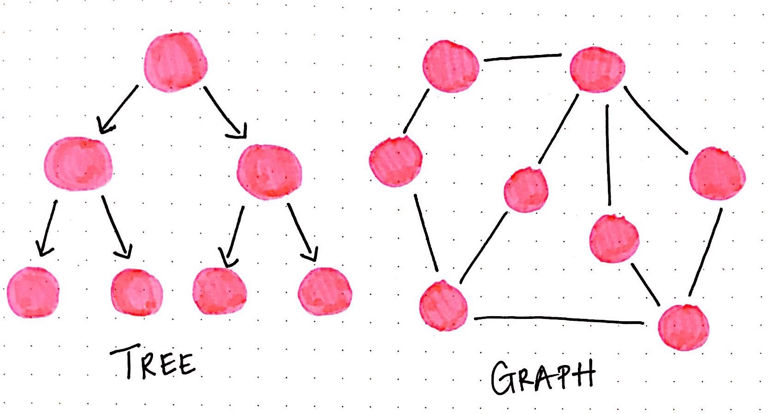
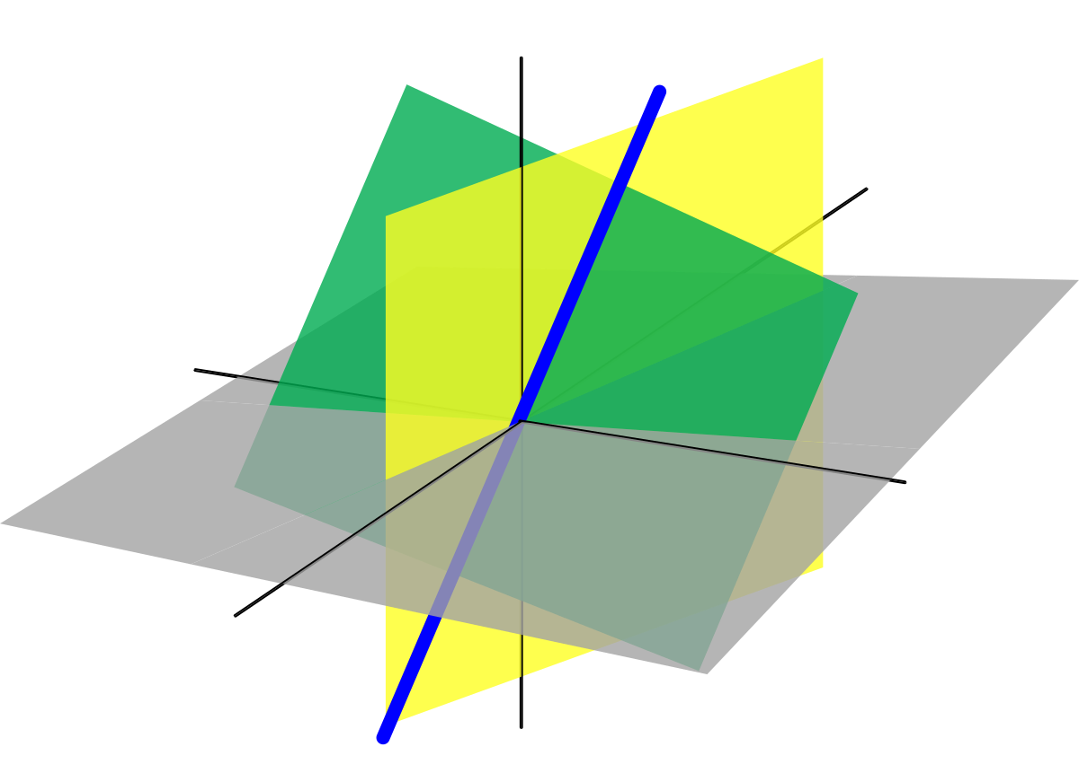
Machine Learning Mathematics

Slide 6
So What Happened Last Week?

Slide 7
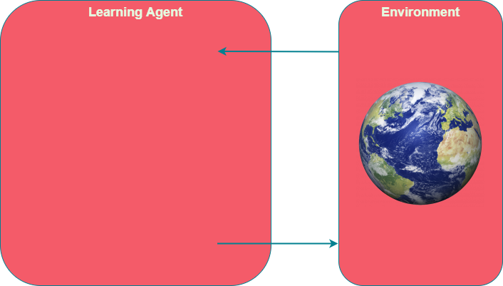
So What Was ML Again?

Slide 8
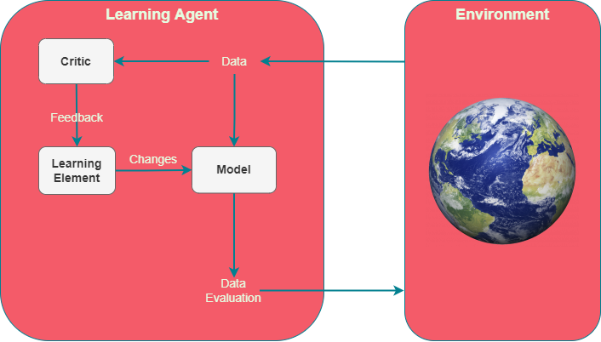
ML at its Core
Critic evaluates performance
Learning element learns from feedback
Model Analyses data

Slide 9
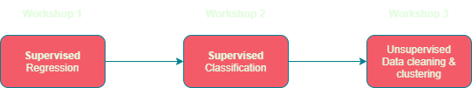
Workshop Timeline

Slide 10
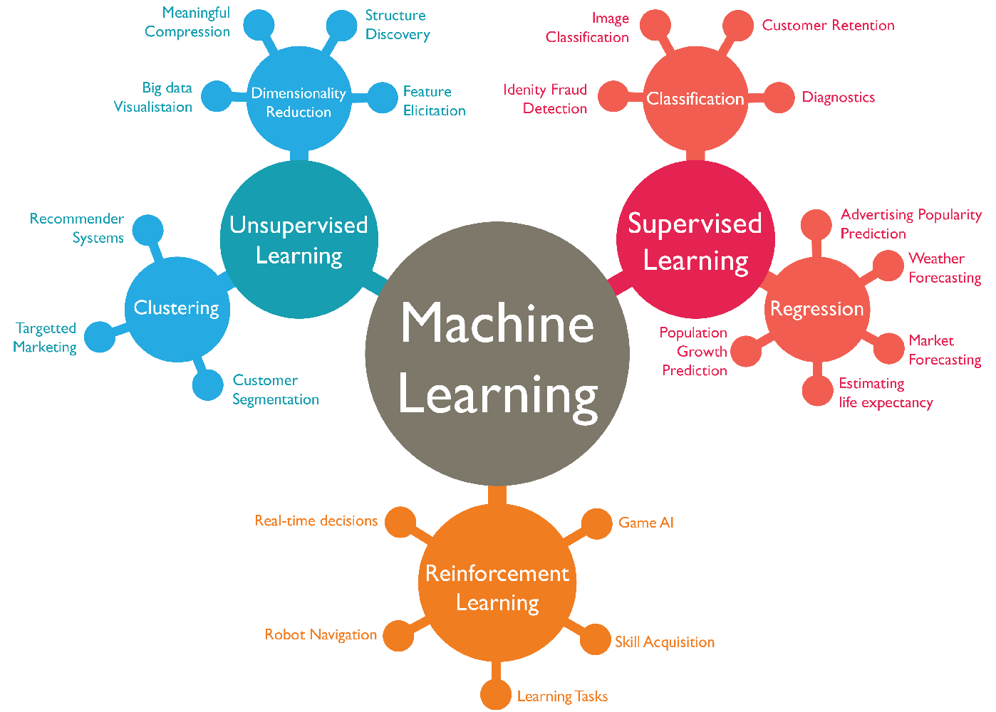
Main Types of ML
Supervised
Train a predictor
Unsupervised
Organise unstructured data
Reinforcement
Real time feedback

Slide 11
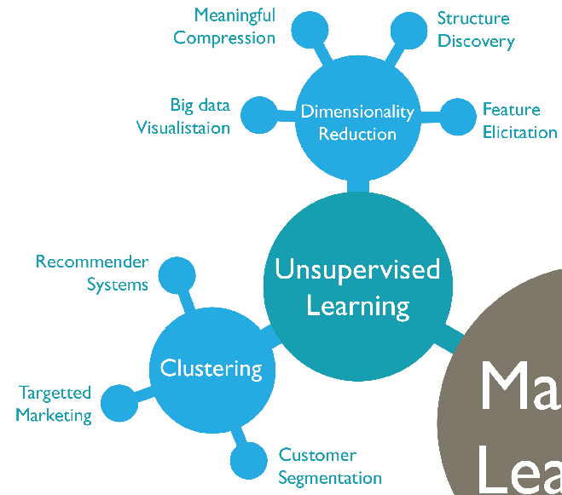
Unsupervised Learning
Finding patterns in data
Reducing dimensions
Novelty Detection

Slide 12
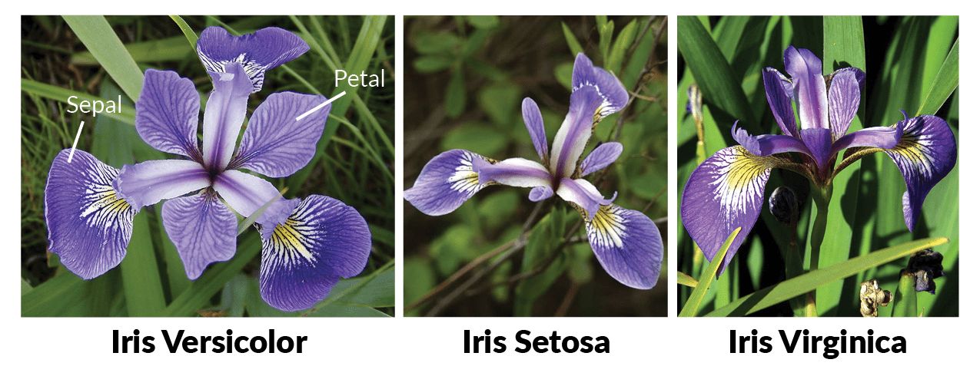
Iris dataset

Slide 13
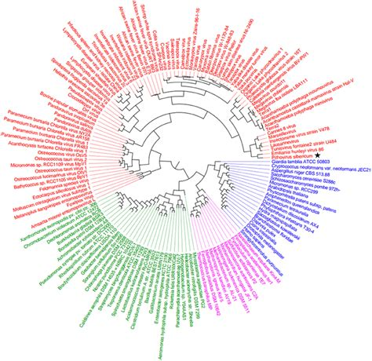
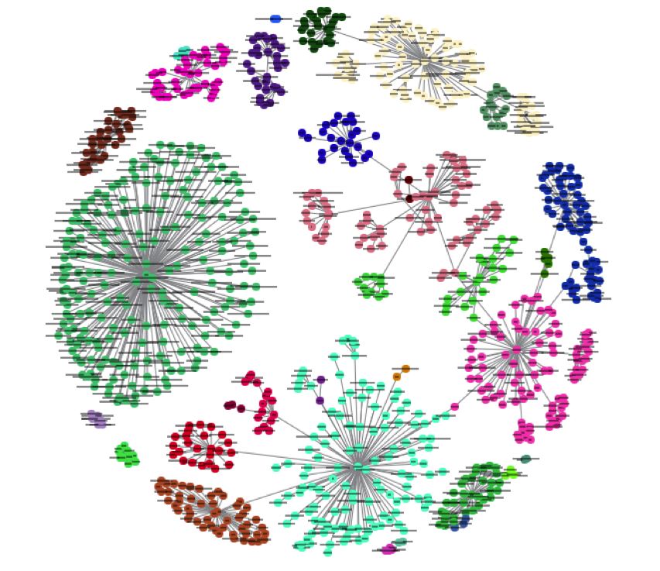
Clustering
Sometimes, you just have a mess!

Slide 14
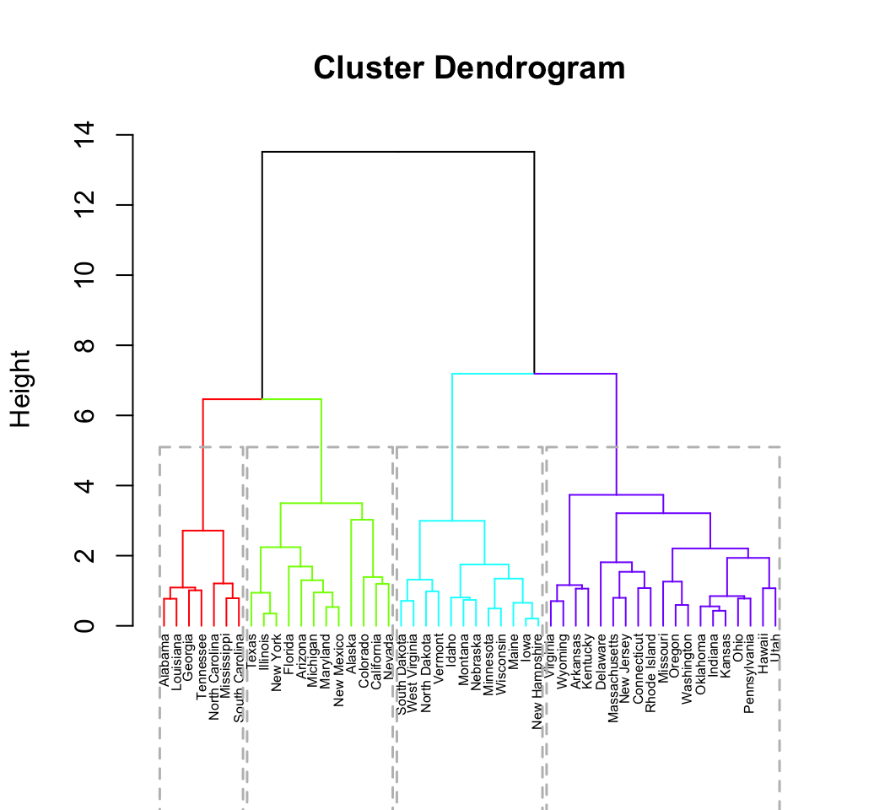
Hierarchical Clustering
Combine/split clusters
Repeat until done
Very slow!!

Slide 15

K-Means

Slide 16
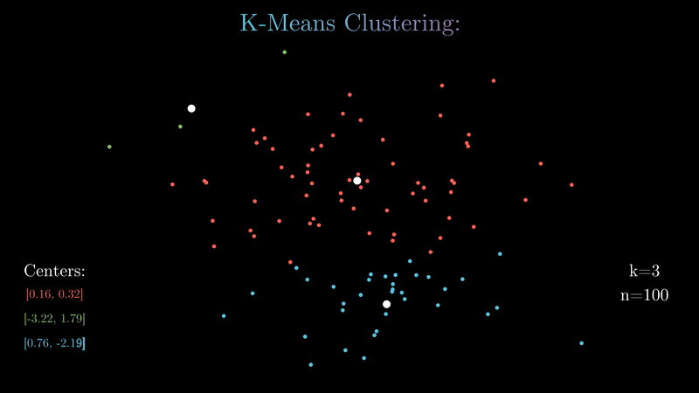
K-means

Slide 17
Enough talk, let’s do it!

Slide 18
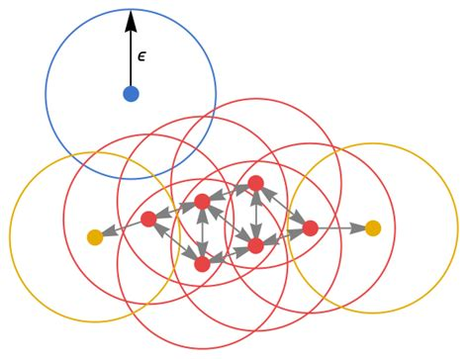
DBSCAN
Find core points
Core if within ε distance of min number of points
Connect core points with each other
Connect other points within ε of a core point
Detect outliers

Slide 19
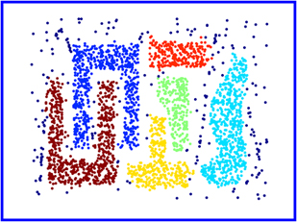
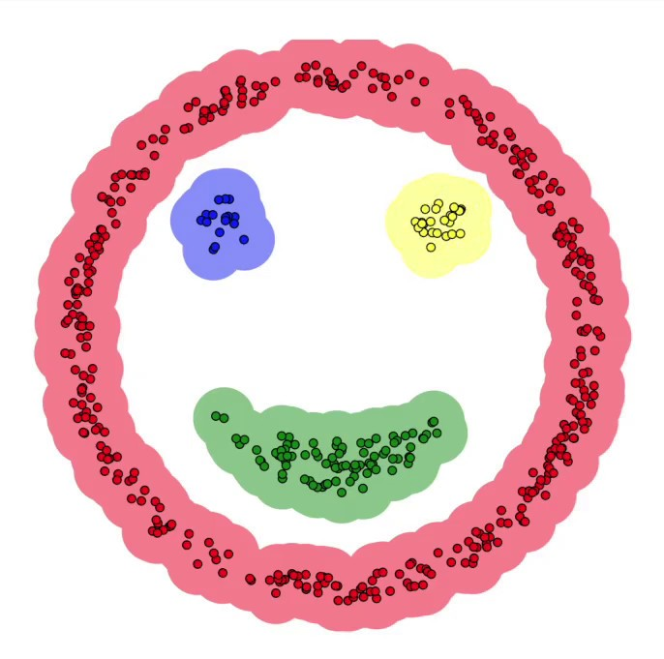
DBSCAN - Pros

Slide 20
Let’s try DBSCAN!

Slide 21
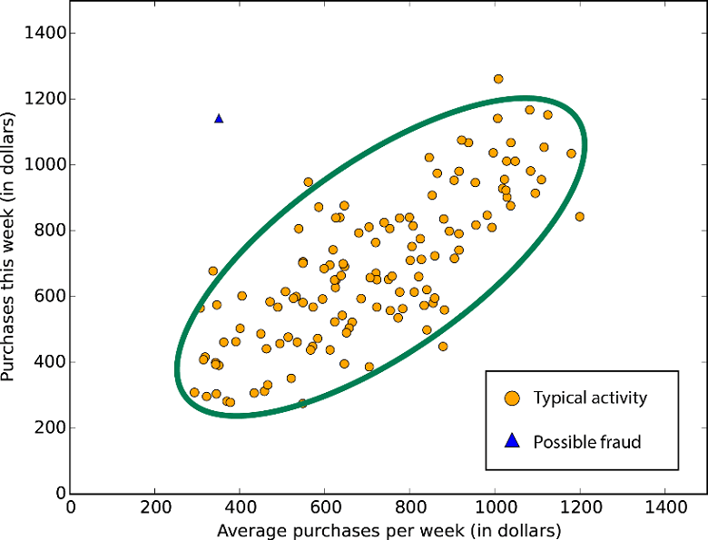
Anomaly Detection
Fraud detection
Unnoticed bugs
Login location
Malfunctioning sensor

Slide 22
What are features?
Model
Fraudulent purchase?

Slide 23
How about these?
Location
Model
Cost
Fraudulent purchase?
Item
Quantity
Purpose

Slide 24
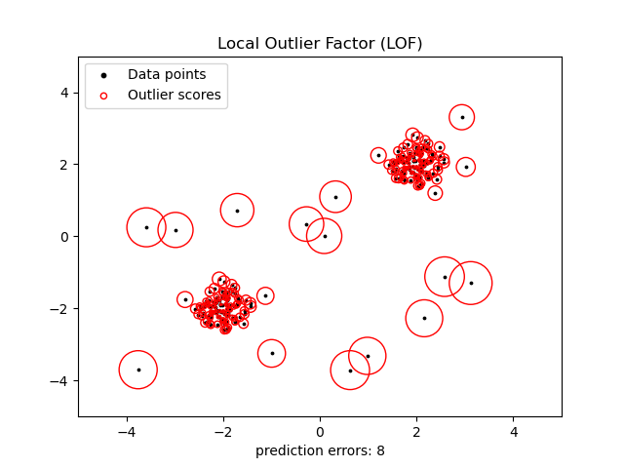
Local Outlier Factor
Uses KNN to find nearest neighbours.
Each point is evaluated relative to its neighbours.
Points whose densities are less than their neighbours are outliers.

Slide 25
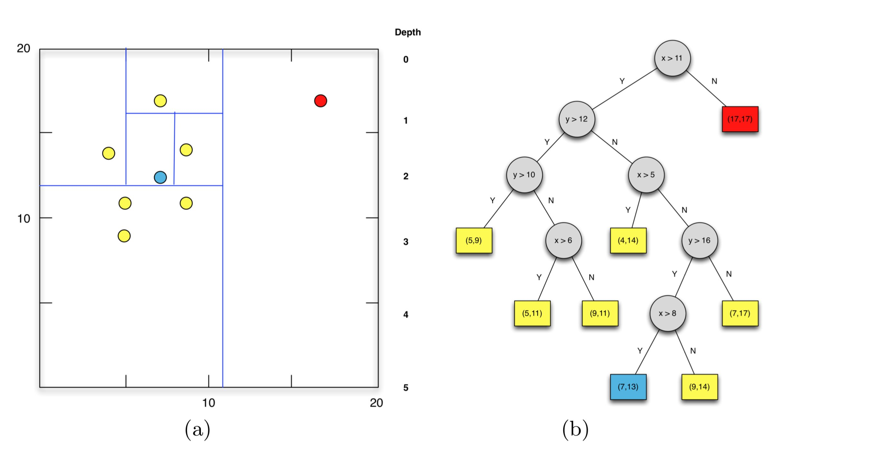
Isolation Forest

Slide 26
Let’s try Novelty Detection

Slide 27
And We’re Done!
Regression
Linear
Polynomial
Exponential
Non-parametric
BIC
Classification
Logistic regression
SVM
Decision Trees
KNN
Confusion Matrix
Unsupervised
K-means
DBSCAN
PCA
LOF
Isolation Forests

Slide 28
What’s Next?
Tutorials
Projects
Google ML course
3Blue1Brown videos
Exploring NNs – Sem 2!
Handwriting detection
Face detection
Audio processing
Voice recognition

Slide 29
Bibliography
Jupyter Notebook: https://jupyter.org/
Google ML glossary: https://developers.google.com/machine-learning/glossary/#m
IBM Machine Learning: https://www.ibm.com/cloud/learn/machine-learning#toc-real-world-Lyja9GSr
GeeksforGeeks Machine Learning: https://www.geeksforgeeks.org/machine-learning/

